Slide 1

Capstone III Data Industry salaries
Presented by: Riley Lewis

Slide 2
Data Used
This Analysis was done on a dataset that comes from Kaggle.
The data set contains information on salaries of people in the data industry (DBA's, Developers, Analysts etc.) from 2017 to 2022

Slide 3
Goal
I would like to answer two questions using the data:
1. The first is to see if there is a significant correlation between years in the data industry and if employees are looking for another job. This could help employers think about if and when extra measures should be taken to ensure employee retention as employees' time in the industry goes on.
2. The second is to see if there is a significant difference in the salaries of employees in large cities (300K-1M population) and metropolises (1M+ population). This could help employers establish a better understanding of compensation based on demographics of employees.

Slide 4
Hypotheses
Null Hypothesis 1: There is not a significant correlation between years in the data industry and if employees are looking for another job.
Alternate Hypothesis 1: There is a significant correlation between years in the data industry and if employees are looking for another job.
Null Hypothesis 2: There is no significant difference in the salaries of employees in large cities and metropolises.
Alternate Hypothesis 2: There is a significant difference in the salaries of employees in large cities and metropolises.

Slide 5
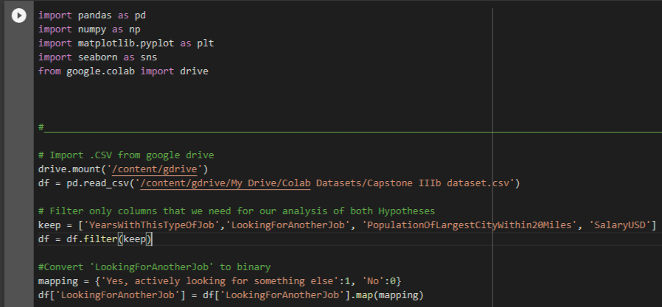
Hypothesis 1: Cleaning
In Google Colab I imported the necessary python packages to clean, analyze, and visualize the data.
I then imported the dataset from my Google Drive, then filtered so that only necessary values would be included in the analysis.
The next step was to convert the string values “YearsWithThisTypeOfJob” and “LookingForAnotherJob” to binary so that it could be used in the visualization and statistical testing necessary to test Hypothesis 1.

Slide 6
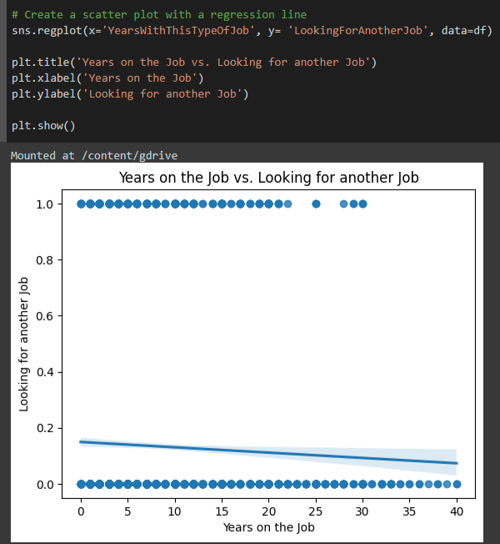
Hypothesis 1: Visualization
Here we have a scatter plot showing the correlation between employees’ years on the job and whether they are looking for another job. The closer the regression line is to 0.0, the less correlation is observed.

Slide 7
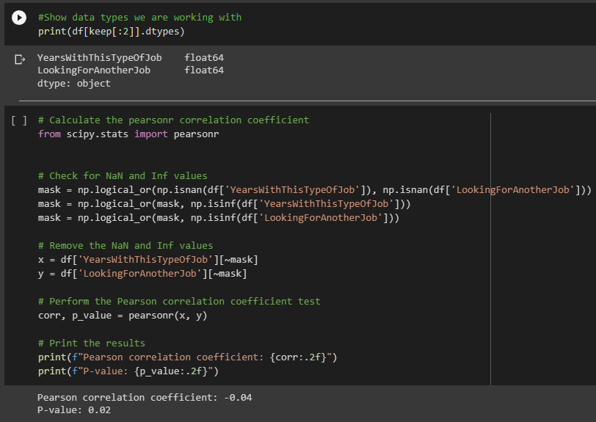
Hypothesis 1: Pearson R correlation test
Finally, I ran a Pearson R correlation test to test our hypothesis and got the following values:
Pearson correlation coefficient: -0.04
Fail to reject the Null Hypothesis: There is not a significant correlation between the years on the job and whether employees are looking for another job.

Slide 8
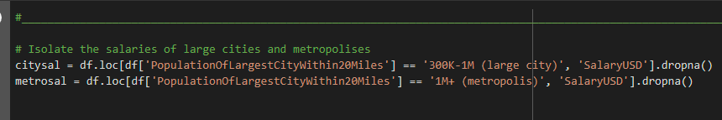
Hypothesis 2: Cleaning
I assigned the salary values for large cities (300K-1M population) and metropolises (1M+ population) to the variables citysal and metrosal respectively, as well as dropping any null values.

Slide 9
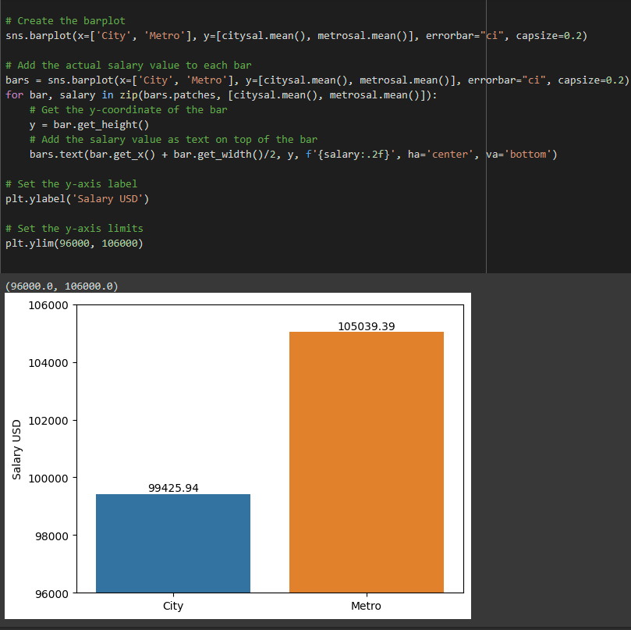
Hypothesis 2: visualization
Here we have a bar plot showing the mean salaries in $USD of both large cities and metropolises.

Slide 10
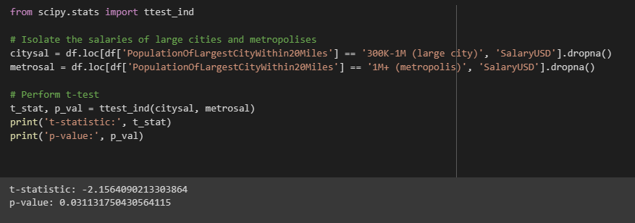
Hypothesis 2: Independent samples t-test
Finally, I ran an independent samples t test and got the following values:
t-statistic: -2.156
p-value: 0.0311
Reject the Null Hypothesis: There is a significant difference in the salaries of employees in large cities and metropolises.

Slide 11
Conclusion
We can see that there is not a significant correlation to employees' years on the job and whether they are looking for a new job. While adding extra perks and incentives can't hurt as far as employee retention goes it appears that as things stand statistically, there is no need for action here.
We can also see that there is a significant difference in the average salaries between employees in large cities (300K-1M population) and employees in metropolises (1M+ population), employees in metropolises averaging in at $5613.45 USD annually more than those in large cities. Knowing this, it should give employers insight into how they could frame negotiations for employees’ salary based on demographics.
For a closer look at the technical aspects of this analysis, you can find the Google Colab notebook here.

